Slide 1


WEBINAR
Making Open Access Agreements More Transparent for Authors
January 27, 2022

Slide 2


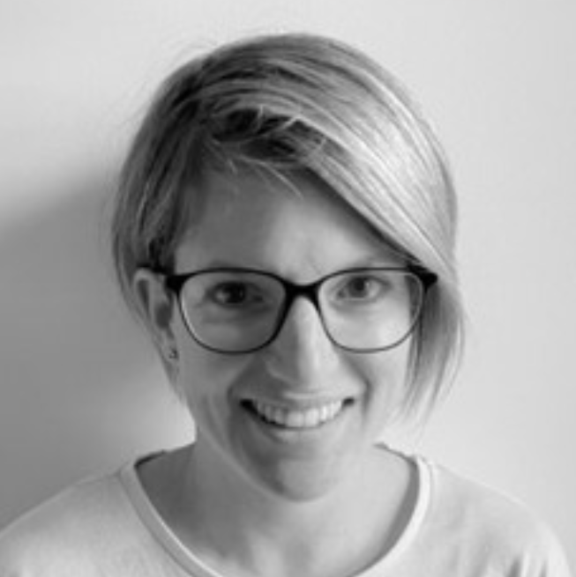
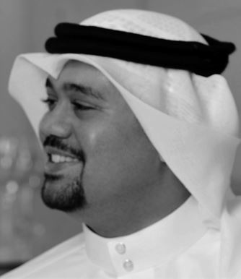
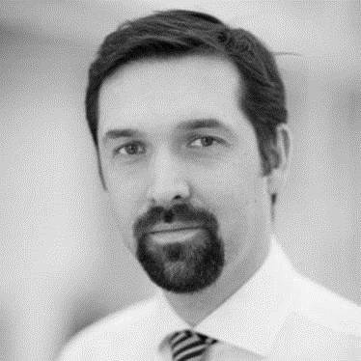
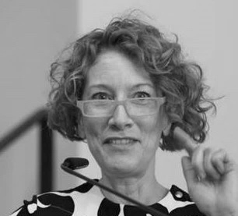
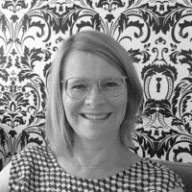
CHRONOSHUB WEBINAR
Making Open Access Agreements more Transparent for Authors
Our moderator
Qatar National Library
Springer Nature
Max Planck Digital Library
American Chemical Society
Romy Beard
Dr. Alwaleed Alkhaja
Christopher Pym
Colleen Campbell
Sybille Geisenheyner
Publisher Relations at ChronosHub
Senior Intellectual Property Librarian and Open Access Coordinator
Senior Institutional Engagement Manager
Team Lead for the Open Access Transition and External Affairs
Director of Open Science Strategy & Licensing

Slide 3
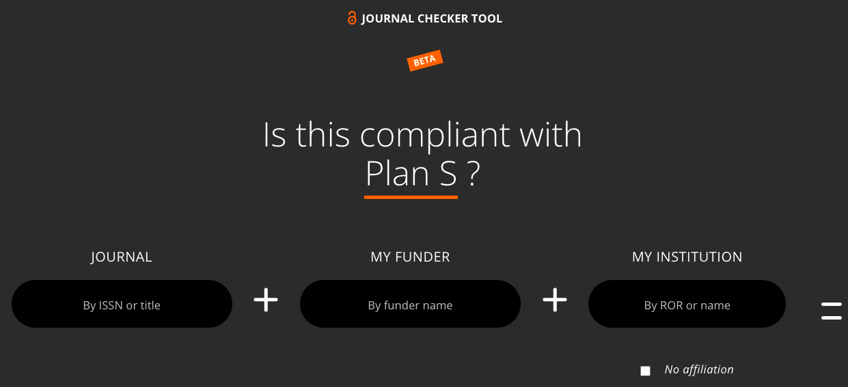
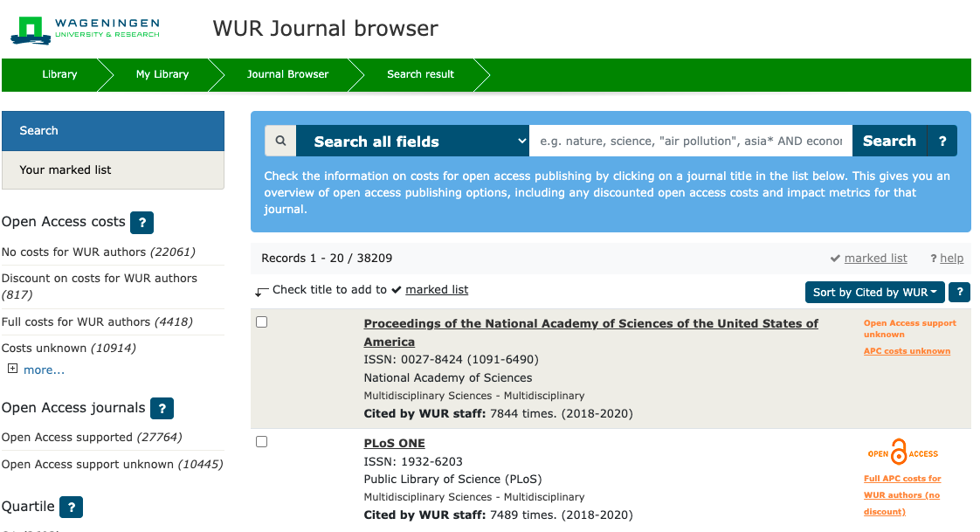
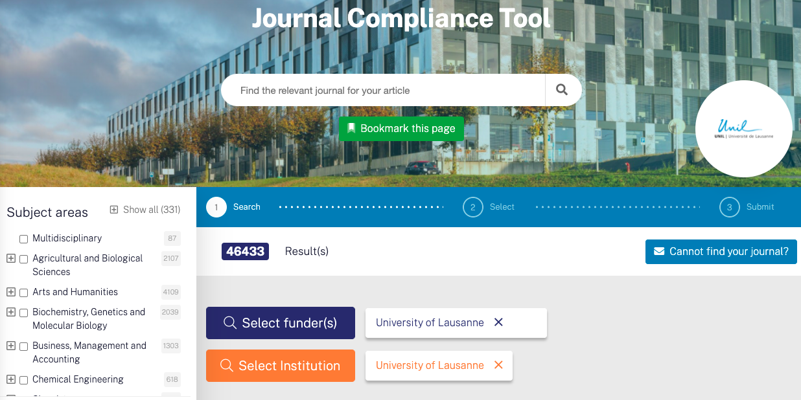
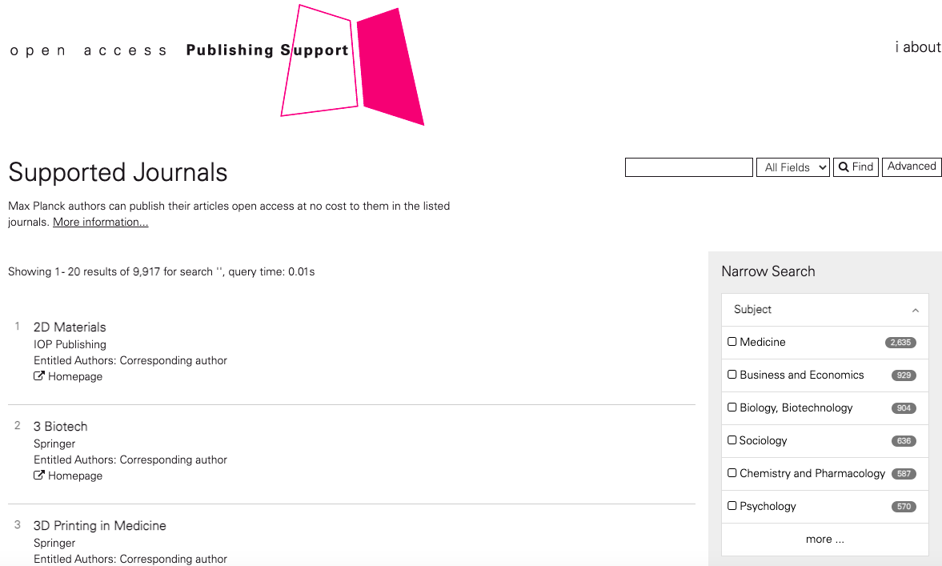
TOOLS TO HELP AUTHORS
JOURNAL CHECKERS
Check agreement eligibility status of specific journals like the
Plan S Journal Checker Tool https://journalcheckertool.org
JOURNAL FINDERS
Allow browsing journals and filtering by different criteria:
Some include a wider pool of journals like
  Wageningen University
  https://library.wur.nl/WebQuery/wurbrowser?q=*
  University of Lausanne https://unil.chronoshub.io/
  American Chemical Society https://acs.chronoshub.io
Others limited to journals included in agreements like
  MPDL https://oapublishing.mpdl.mpg.de/journals/

Slide 4

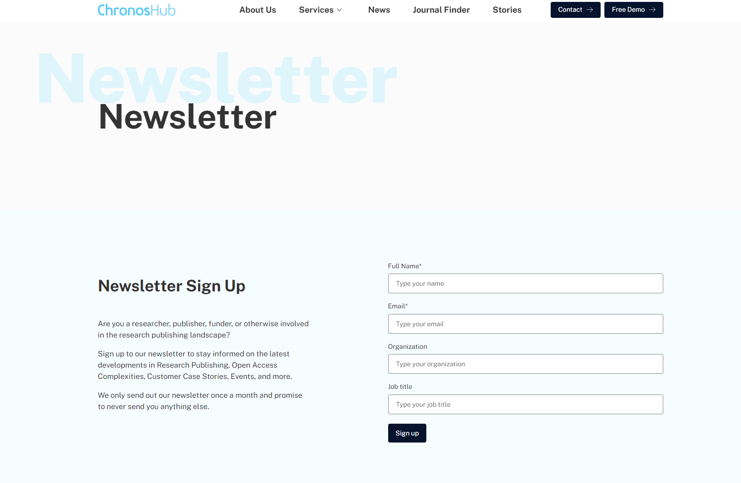
NEWSLETTER &
UPCOMING EVENTS
Sign up for our newsletter to stay informed on the latest developments in research publishing, open access complexities, customer case stories, future webinars, events, and much more.
We only send out our newsletter once a month – less is much more.
Sign up here: https://chronoshub.io/newsletter/

Slide 5
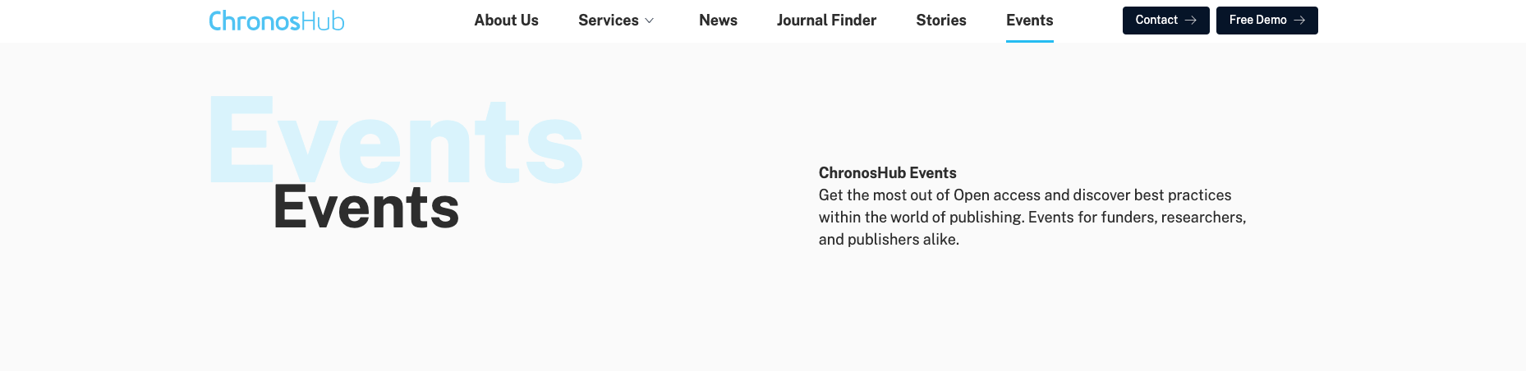
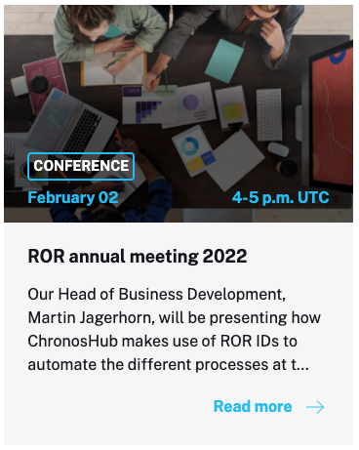
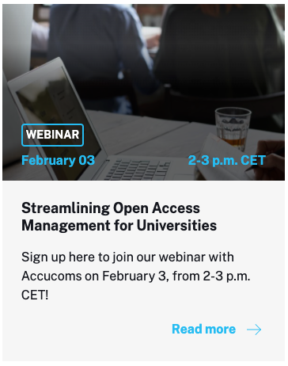
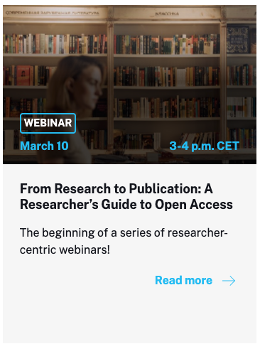

Slide 6



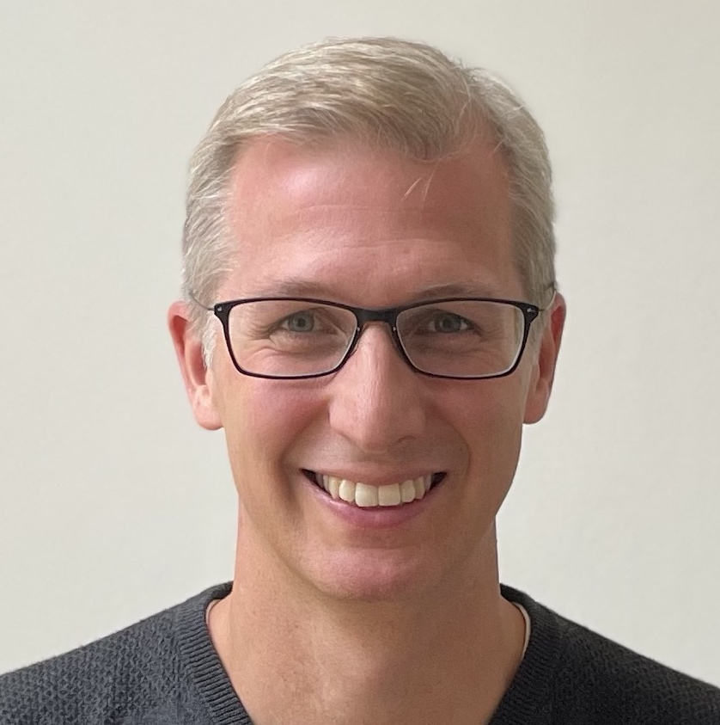
QUESTIONS
PLEASE CONNECT WITH US
@Chronoslimited
@chronoshub
@chronoshub
Romy Beard
Publisher Relations
rb@chronoshub.io
Martin Jagerhorn
Head of Business Development
mj@chronoshub.io
Notes:
https://chronoshub.io/
https://www.linkedin.com/company/chronoshub/posts/?feedView=all
https://www.facebook.com/chronoslimited
https://twitter.com/chronoshub?lang=ca
Facebook: @Chronoslimeted
Andet @chronoshub

