Slide 1


Five Tips
Understanding
Today’s User Expectations
in Scholarly Publishing
UKSG Forum
5.12.2023

Slide 2

Speaker
Jan Rylewicz
Business Development Consultant
ChronosHub

Slide 3
Agenda
01
Author’s Experiences
with Today’s Products
02
Author’s Needs and Expectations
03
Tips for Better
Author Experiences

Slide 4
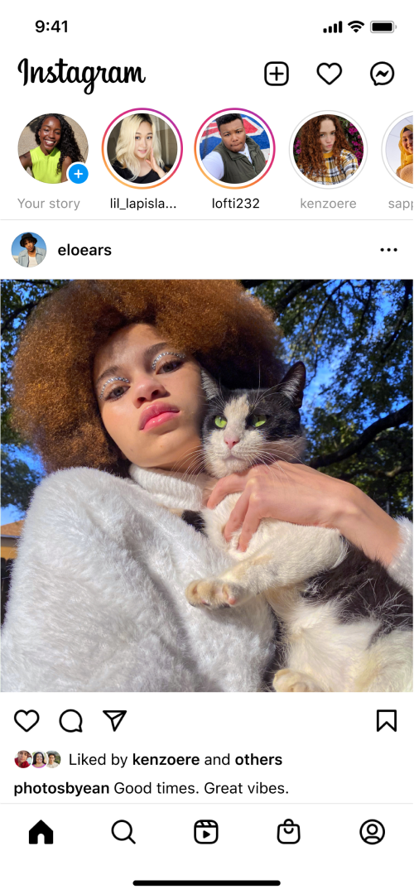
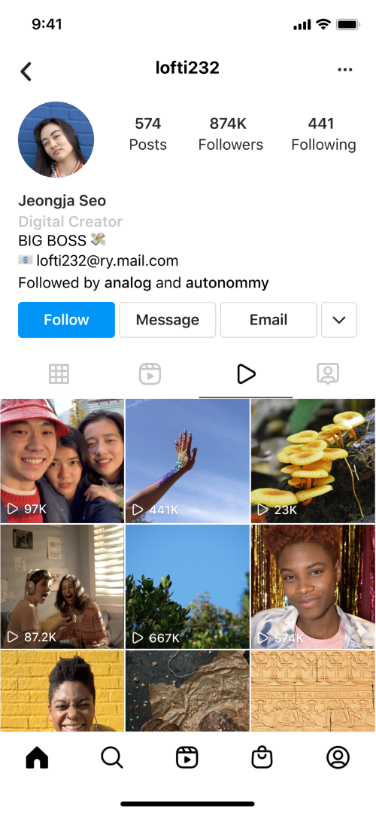
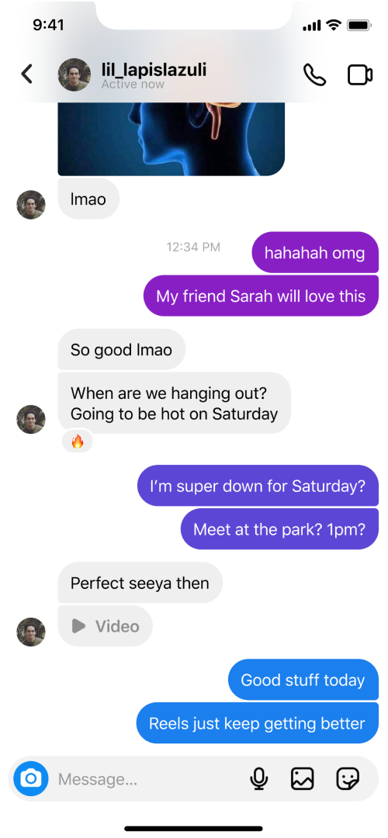


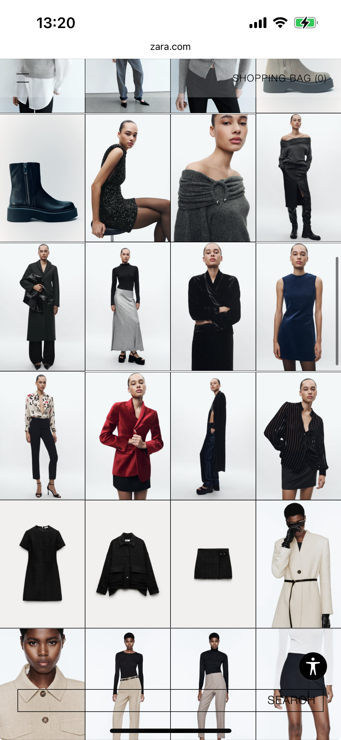
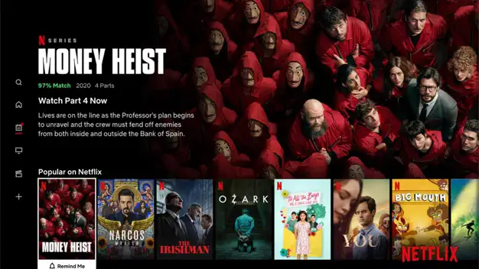












Today’s Authors
Social media
Online stores
Entertainment platforms
Instagram - Photo & Video Sharing Service
Instagram
Divide - Store
Rusland Siiz
Netflix - Streaming Service
Netflix
Instagram
TikTok
X
Snapchat
Amazon
Etsy
Zara
Farfetch
Netflix
Spotify
YouTube
Hulu
What can we learn from these?

Slide 5
Today’s Authors
Social media
Online stores
Entertainment platforms
Instagram - Photo & Video Sharing Service
Instagram
Divide - Store
Rusland Siiz
Netflix - Streaming Service
Netflix
Instagram
TikTok
X
Snapchat
Amazon
Etsy
Zara
Farfetch
Netflix
Spotify
YouTube
Hulu
Bite-size information
Responsiveness
Personalization

Slide 6
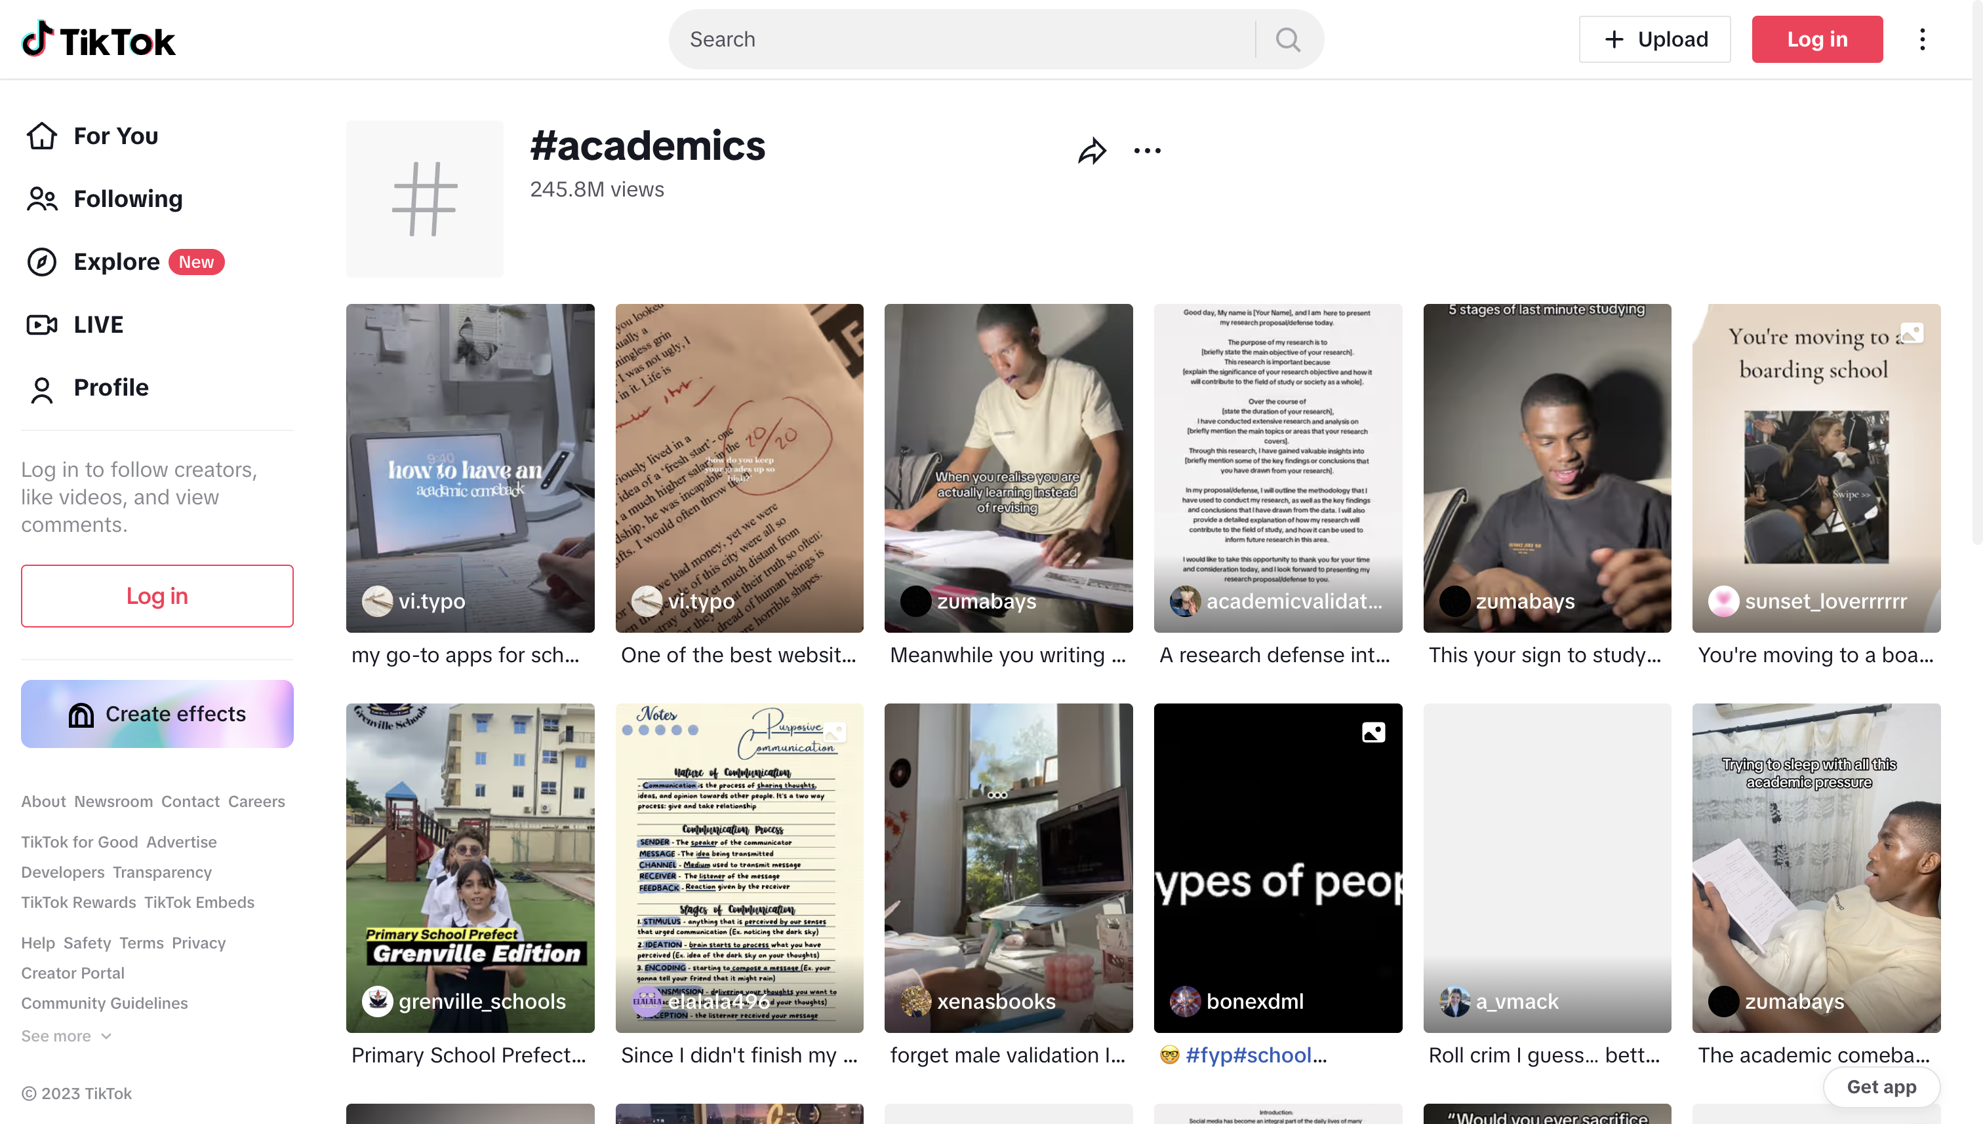

Social Media and the Scholarly Space
TikTok
and the power
of algorithms
Search results for academics tag
TikTok

Slide 7
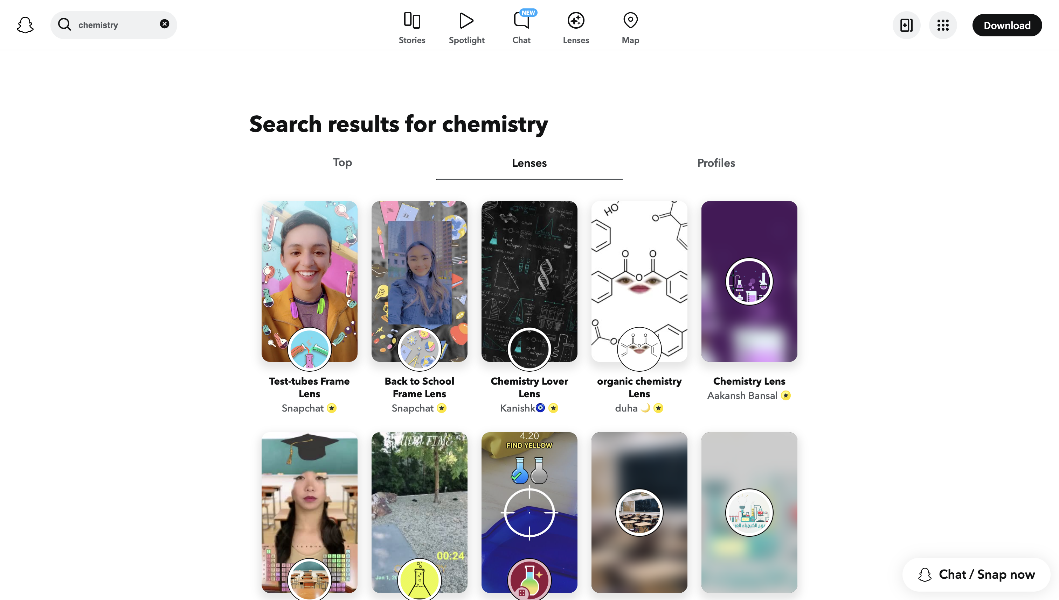
Social Media and the Scholarly Space
Snapchat
and the power
of learning
Search results for chemistry
Snapchat

Slide 8
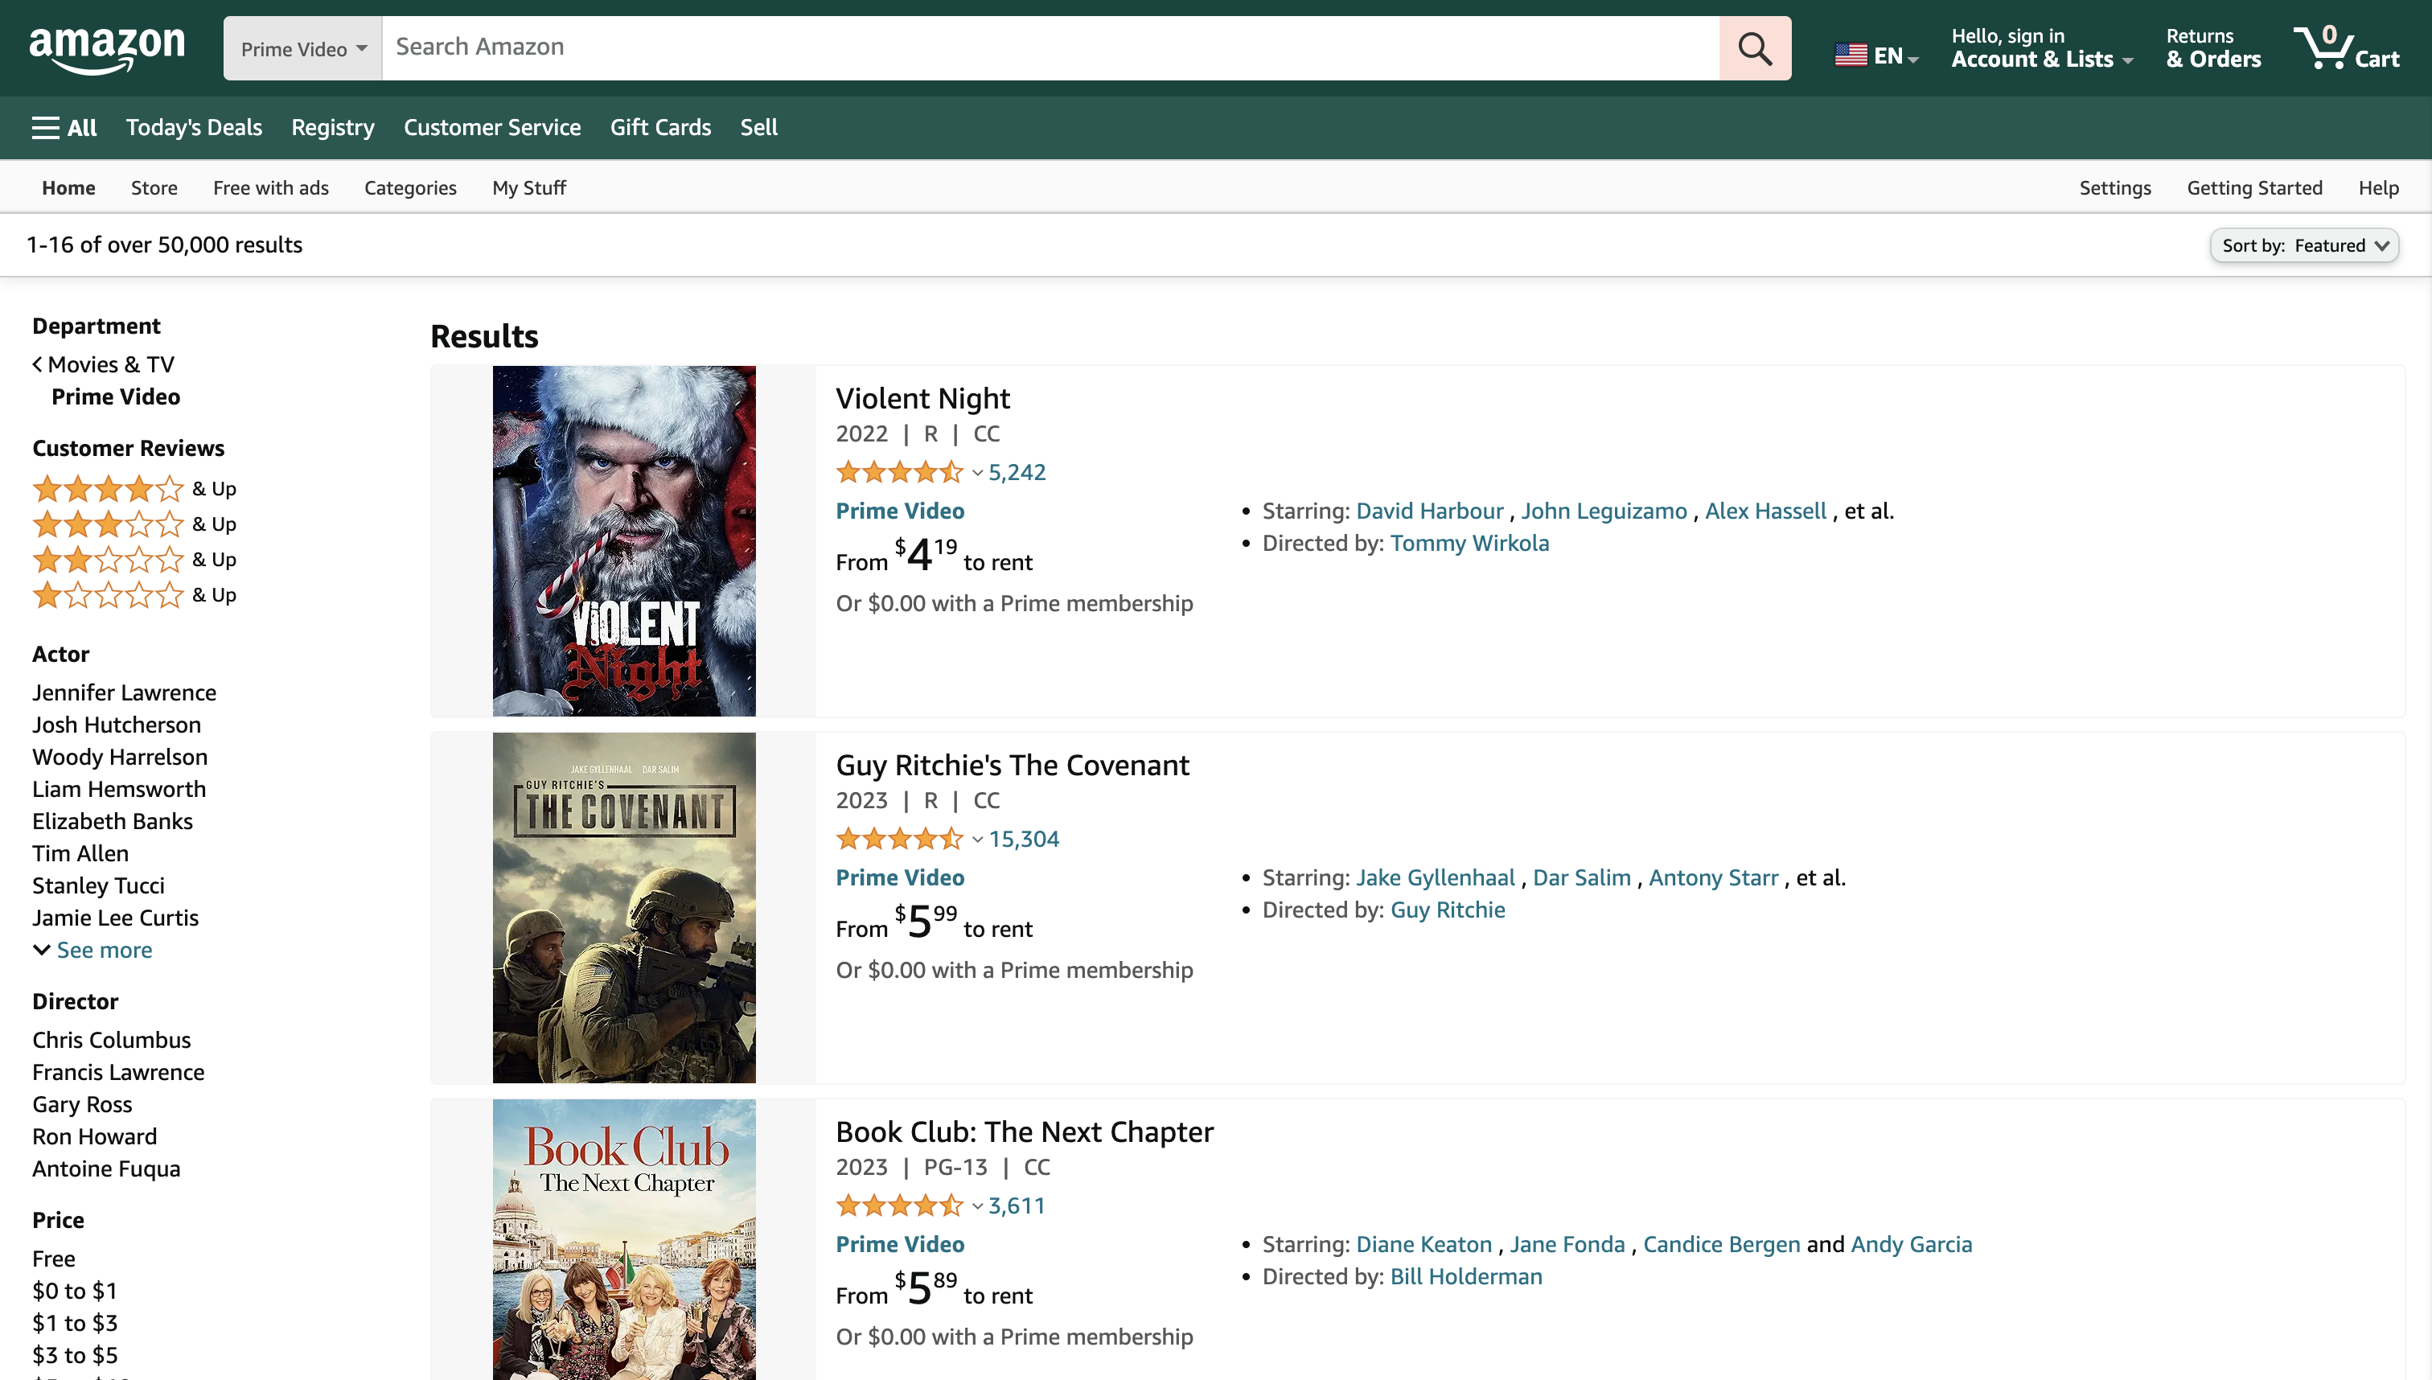
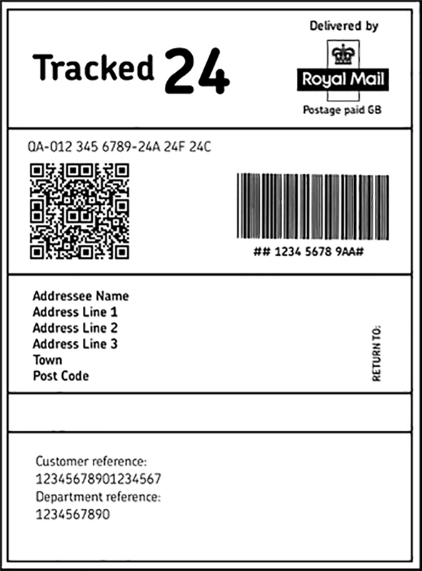
Social Media and the Scholarly Space
Amazon:
clear options
and seamless
experience
Rent Or Buy - Prime Video: Movies & TV
Amazon

Slide 9
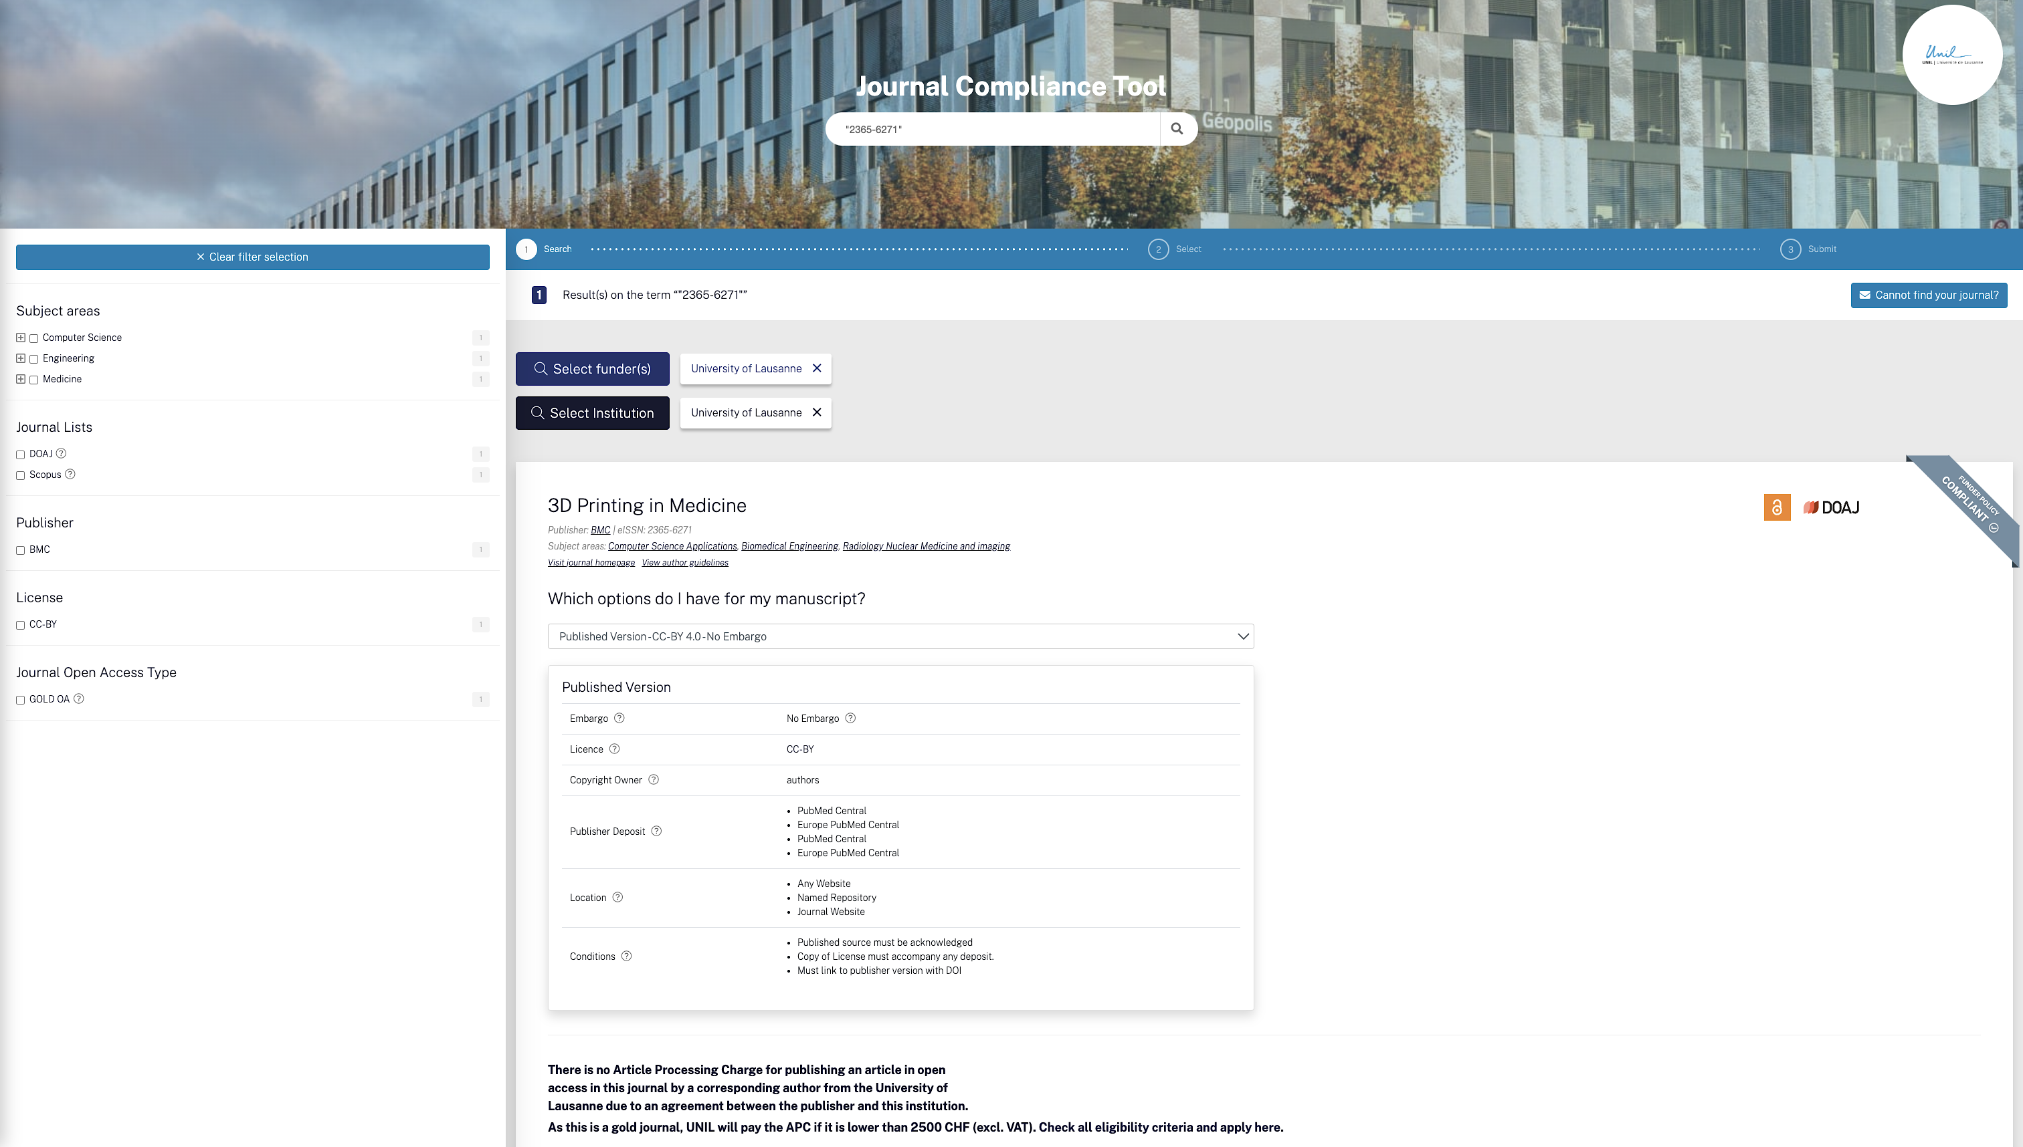
Clear Guidance for Authors
Journal Guide:
visibility of
information:
funder policy
compliance &
transformative
agreement
conditions
Journal Guide
ChronosHub

Slide 10
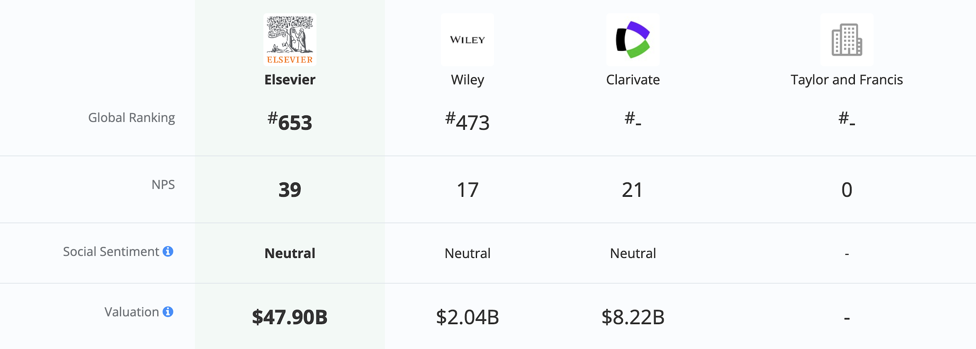
What Do Authors Find Useful?
Comparison of NPS among publishers
Comparably

Slide 11

What Do Authors Find Useful?

Slide 12


What Do Authors Find Useful?
Speed of reviewing process
Speed of publication after acceptance
Editor/editorial board
Standard of reviewing
Impact Factor of the journal
Overall reputation/status of the journal
Audience/readership of the journal
Option for article to be published Open Access
Author Feedback Programme: Needs Assessment
Elsevier

Slide 13
Five tips for a better author experience

Slide 14

1
ONE LOGIN
Avoid multiple logins
Leverage integrations
Provide a consistent experience

Slide 15


1
ONE LOGIN: TAMPERE UNIVERSITY LOGIN WITH HAKA
Tampere University Login with Haka
Tampere University

Slide 16

2
MANUAL VERSUS AUTOMATION
Choose manual or automation appropriately
Personalized manual workflows or…
…tailored automated workflows?

Slide 17
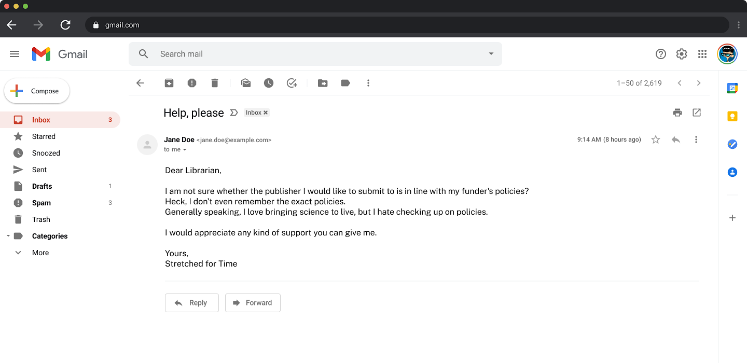
2
MANUAL VERSUS AUTOMATION

Slide 18

3
WORKFLOW LOGIC
Bonus tip: Identify each point at which specific information
is needed by mapping out the end-to-end author experience
Present the right information at the right time
Provide information up front
Reuse information between systems

Slide 19
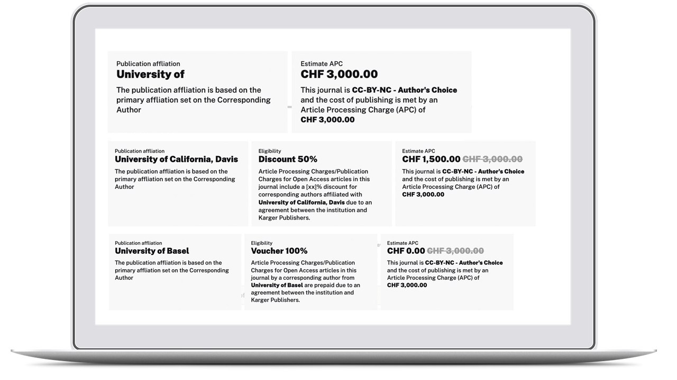
3
WORKFLOW LOGIC
A
B
C
Publishing Options in Manuscript Submission
ChronosHub

Slide 20

4
SIMPLICITY
Avoid overload of information
Request the information only once
Reuse information throughout workflow

Slide 21
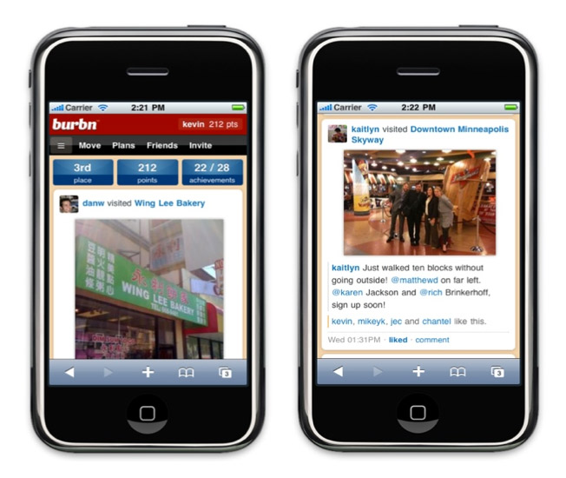
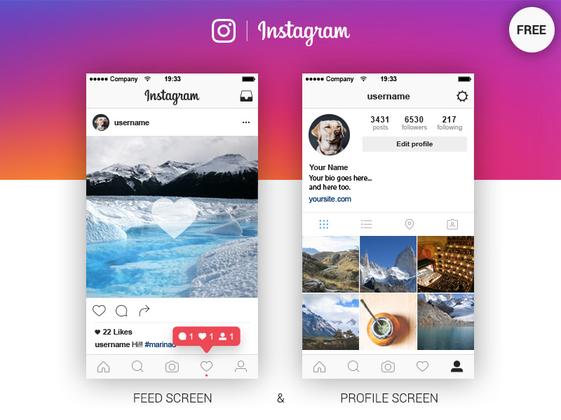
4
SIMPLICITY
From Burbn to Insta(nt success): Based on user-behavior data, Burbn successfully rebranded as Instagram
Redundant features: ‘Check in’ that nobody used
Overly complicated: Several simultaneous features
Primary feature: ‘Photo-sharing’ as feature of interest
Appropriately simple: One (primary) feature

Slide 22
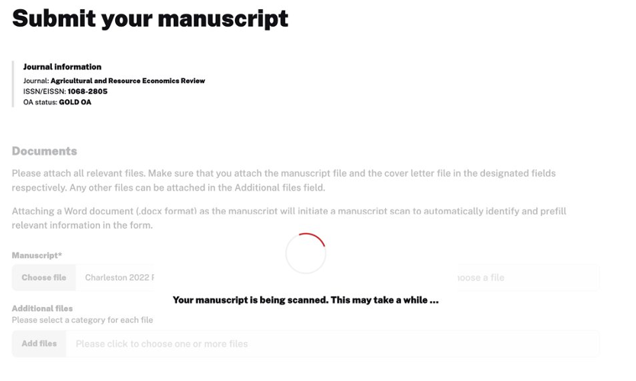

5
“WE DO IT FOR YOU”
Use artificial intelligence to help the author
Limit human input to quality control

Slide 23
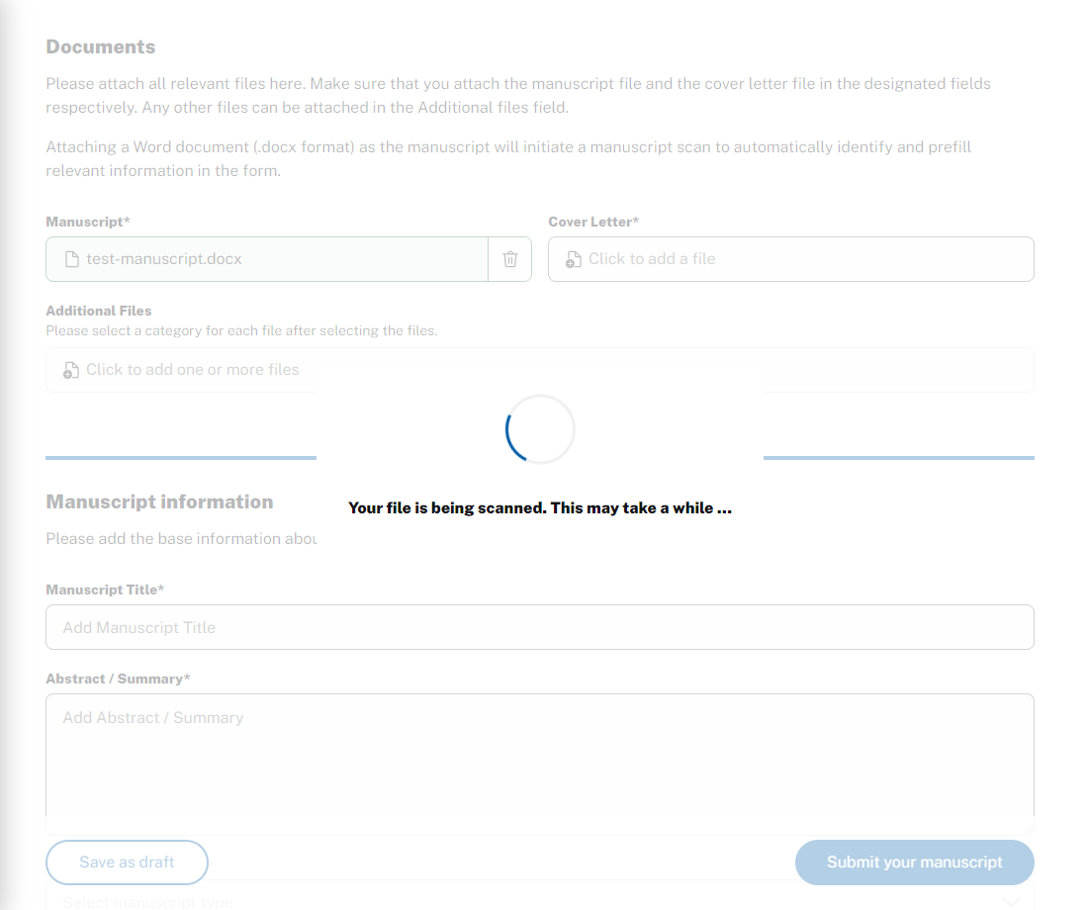
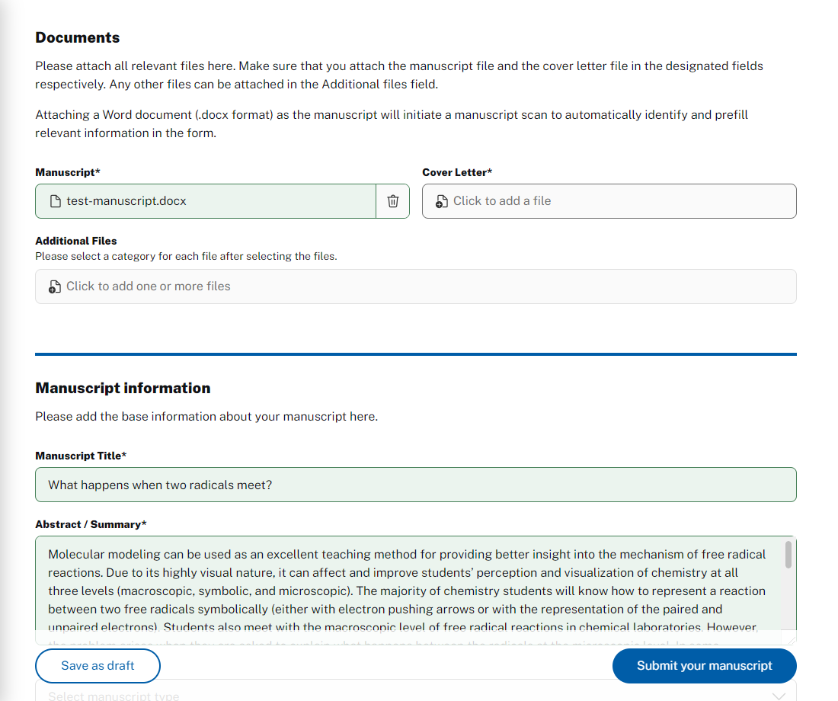
5
“WE DO IT FOR YOU”
Scanning and Entering Information from Manuscript for Manuscript Submission
ChronosHub

Slide 24

To achieve success, careful consideration of approaches
to meeting expectations is essential, ultimately fostering improved author satisfaction and engagement.

Slide 25

Get in touch
Jan Rylewicz
Business Development Consultant
ChronosHub
jr@chronoshub.io

